Slide 1
How are Planets Formed?

Slide 2
An Overview
Pre-solar nebula
Protoplanetary disk: condensation and accretion
Solar wind (beginning of fusion)
Collisions continue
Planetary migration (orbits shifting)
Late Heavy Bombardment (Hadean Era)
Planetary Evolution

Slide 3
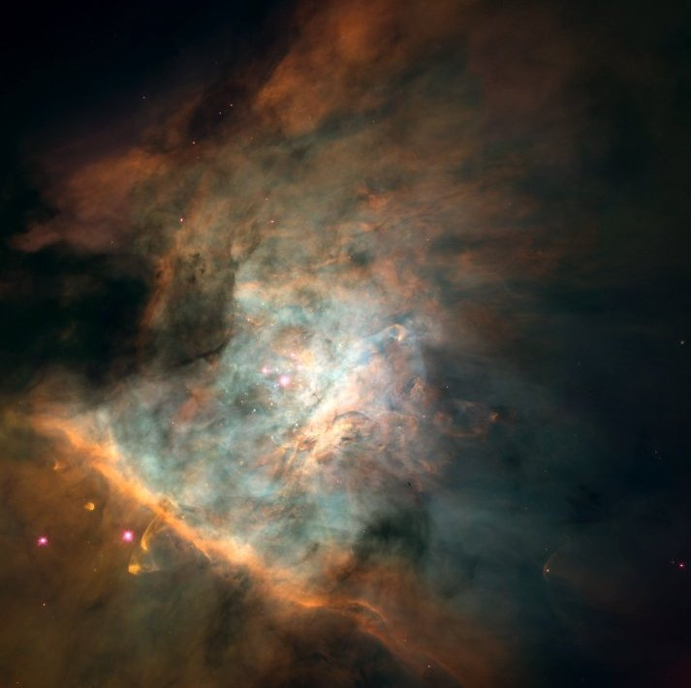
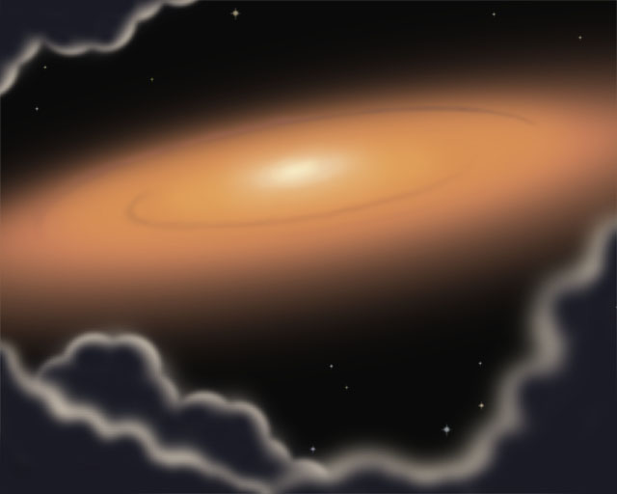
Solar Nebula
“Stellar nursery” of T Tauri stars
  Cluster of stars (right) in condensed hydrogen gas cloud
  How does it get condensed to the point where stars can start to form?

Slide 4
Solar Nebula
“Stellar nursery” of T Tauri stars
  Cluster of stars (right) in condensed hydrogen gas cloud
  How does it get condensed to the point where stars can start to form?
    Shockwave! Neighboring supernovae not only provide initial materials but the density required!
Nursery clears and breaks apart; individual stars left surrounded by spinning gas disk
  Why is it spinning?

Slide 5
Solar Nebula
“Stellar nursery” of T Tauri stars
  Cluster of stars (right) in condensed hydrogen gas cloud
  How does it get condensed to the point where stars can start to form?
    Shockwave! Neighboring supernovae not only provide initial materials but the density required!
Nursery clears and breaks apart; individual stars left surrounded by spinning gas disk
  Why is it spinning? Conservation of angular momentum
Sun is still contracting; soon it will start fusion of H to He (main sequence)

Slide 6
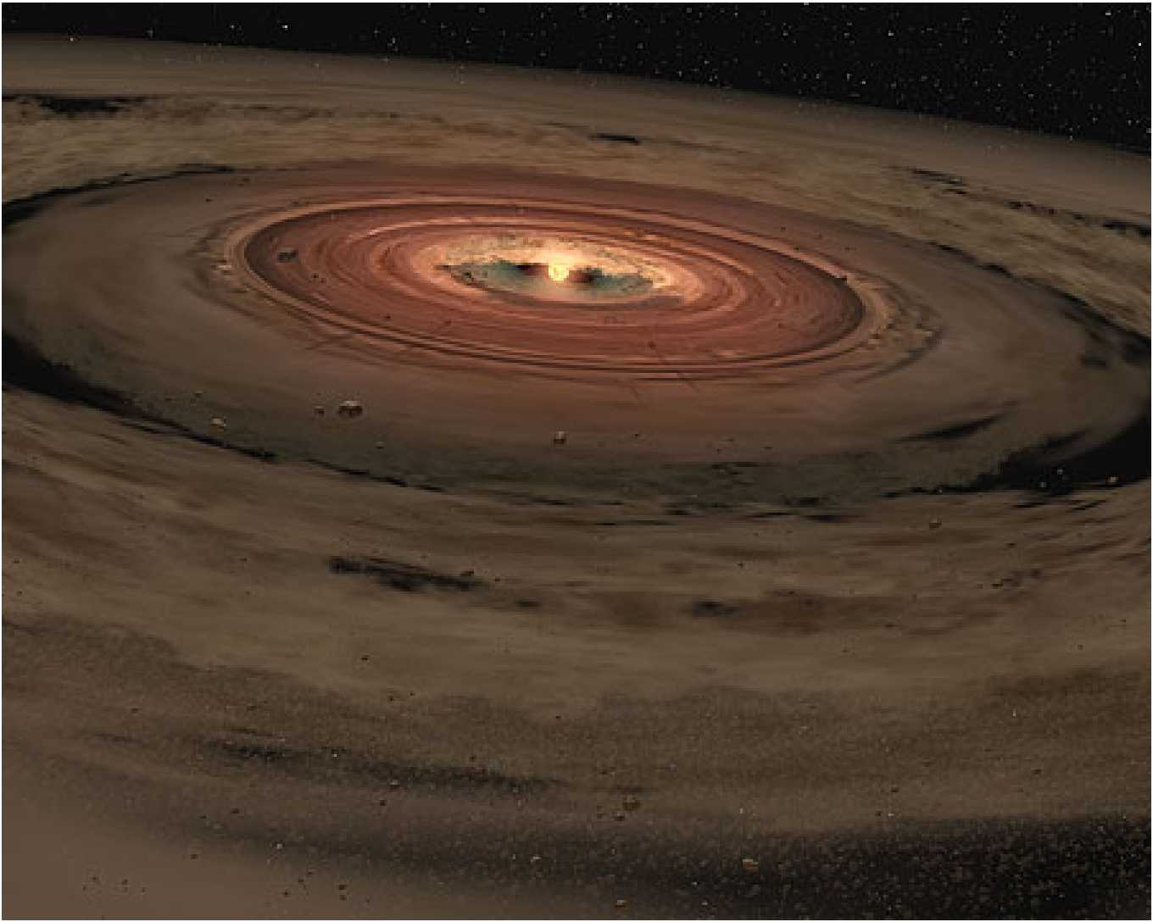
What’s happening to the disk?
Condensation into particles (dominated by electromagnetic force)
  Like a snowball rolling down a hill, they stick together and get bigger
Accretion: gravity takes over and chunks of material attract each other and collide and stick, building up this way
Different radii– different elements available to build planets. Why?

Slide 7
What’s happening to the disk?
Condensation into particles (dominated by electromagnetic force)
  Like a snowball rolling down a hill, they stick together and get bigger
Accretion: gravity takes over and chunks of material attract each other and collide and stick, building up this way
Different radii– different elements available to build planets. Why?
  It’s hot closer in to the sun!
  More elements/molecules are cold enough to accrete further from the sun
  This can be seen in current composition of planets – densest furthest in
Eventually results in multiple planetesimals– often in close orbits.
Finally – sun begins fusion, all dust not accreted is blown away in stellar wind

Slide 8
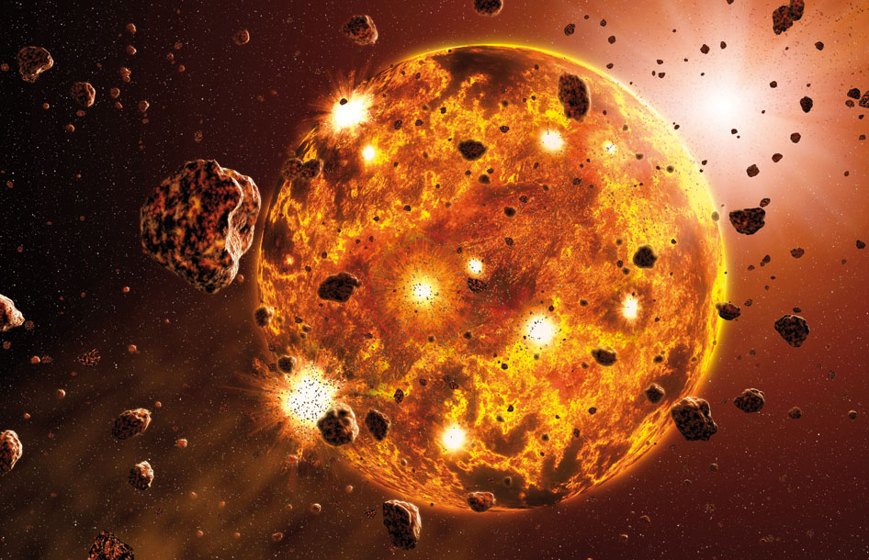
Late-Stage Planetary Formation
Planetesimals collide; full-size planets begin to form
Rearrangement: Nice model
  https://www.youtube.com/watch?v=6LzQfR-T5_A
  For our solar system
  Orbital resonances between Saturn and Jupiter rearranged the solar system
Other solar systems:
  Similar perturbation and
  rearrangement
  Other possible mechanisms?

Slide 9
Late-Stage Planetary Formation
Planetesimals collide; full-size planets begin to form
Differentiation – melting – planets are very HOT (kinetic energy!)
Rearrangement: Nice model
  https://www.youtube.com/watch?v=6LzQfR-T5_A
  For our solar system
  Orbital resonances between Saturn
  and Jupiter rearranged the solar system
Other solar systems:
  Similar perturbation and
  rearrangement
  Other possible mechanisms?
    Wandering star
    Large collisions

Slide 10
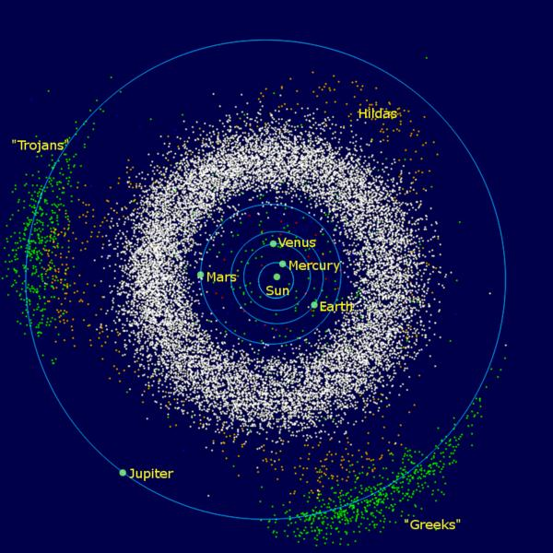
Leftovers
Planetesimals and smaller bodies that did not end up in planets
Asteroid belt, Kuiper belt, Oort cloud
  The asteroid belt and the Trojan asteroids are in the inner solar system, though – why?

Slide 11
Leftovers
Leftovers: asteroid belt, Kuiper belt, Oort cloud
    The asteroid belt and the Trojan asteroids are in the inner solar system, though – why?
JUPITER
Extreme gravity prevents
formation of a planet in this
region – resonance patterns
Trojan asteroids follow in
gravitationally stable
“Lagrange” points 60 degrees
ahead and behind of Jupiter
(based on solution to 2-body
problem with Jupiter and Sun)

Slide 12
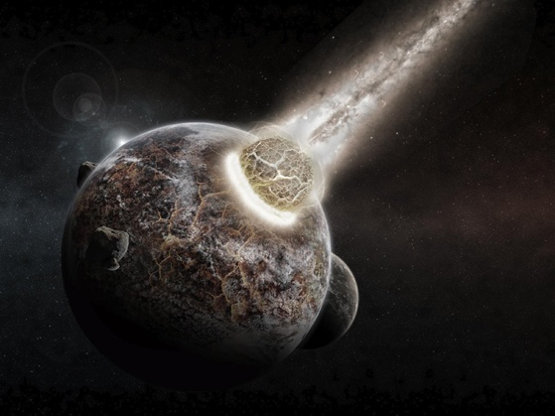
Late Heavy Bombardment
Geological “Hadean era” on Earth
How do we know?

Slide 13
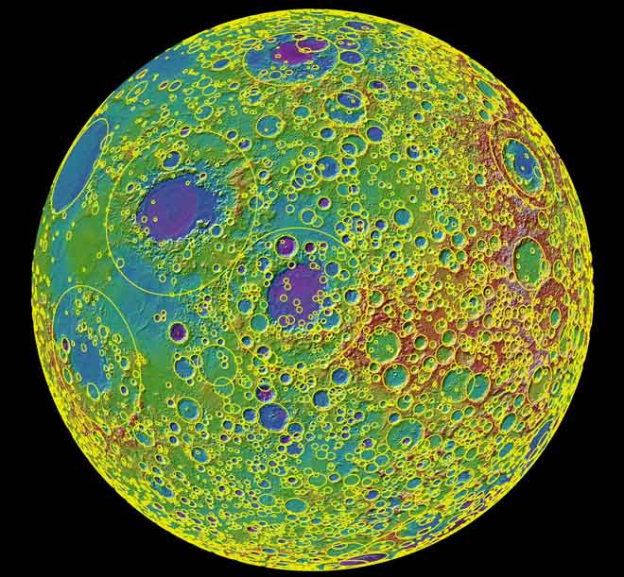

Slide 14
Late Heavy Bombardment
Geological “Hadean era” on Earth
How do we know?
  Evidence: cratering on Moon, Mars, Mercury
What caused it?

Slide 15
Late Heavy Bombardment
Geological “Hadean era” on Earth
Evidence: cratering on Moon, Mars, Mercury
What caused it?
  Basically, un-accreted material in
  unstable orbits hit things.
Altered orbits, surface features
After this, solar system settled
down
  The objects in short-term crossing
  orbits had already hit each other

Slide 16
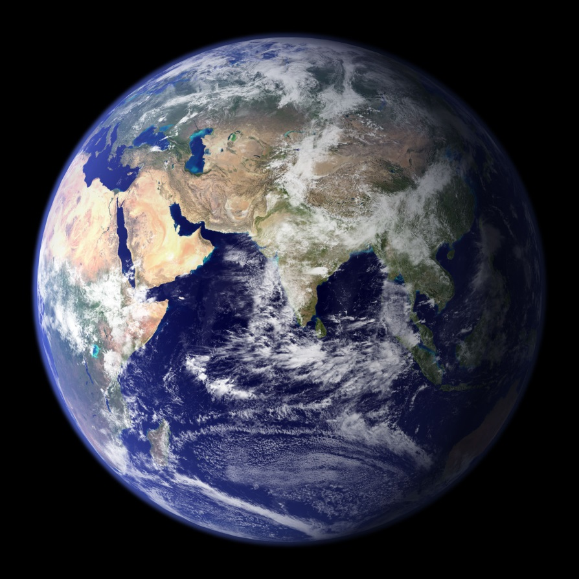
Planetary Evolution
Atmospheres and water
  If terrestrial planets were too hot and small to accrete gases and liquids, how did they get them?

Slide 17
Planetary Evolution
Atmospheres and water
  If terrestrial planets were too hot and small to accrete gases and liquids, how did they get them?
    LHB
    And other collisions – comets and asteroids formed farther away
Structure

Slide 18
Planetary Evolution
Moons and other satellites
  How could a planet get moons?

Slide 19
Planetary Evolution
Moons and other satellites
  How could a planet get moons?
  Co-formation (planets had disks like suns do and satellites accreted)
  Capture
  Other processes: collision and subsequent accretion (Earth’s Moon)
    https://www.youtube.com/watch?v=HKkXVny7Yd8
Surface Processes
  Some internal heating > volcanism and plate tectonics
  Continued collisions
  Actions of atmosphere
  Cooling of the planet (Mercury’s scarps)
  Entropy, chemical and thermal reactions run down to stable states from initial conditions
  Next week: specific examples from the solar system we know the most about!

